Slide 1
Feature Selection
By Dennis Gao and Hector Guerra

Slide 2
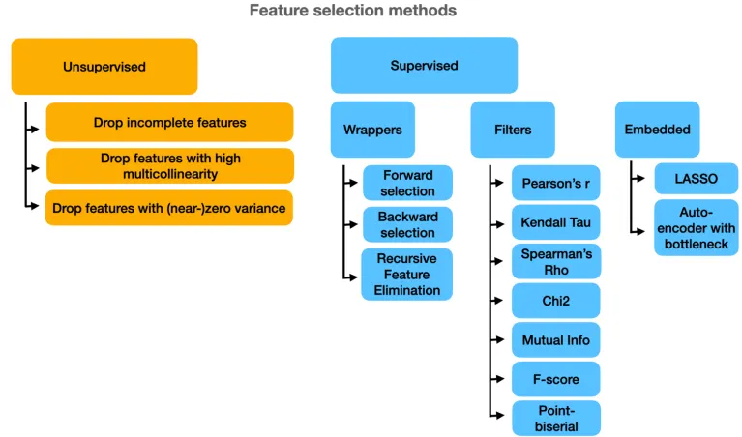
Feature Selection Overview
Supervised Learning - using labeled data to train an algorithm or machine
Feature selection helps identify the features that contribute the most to predicting the target variable.

Slide 3
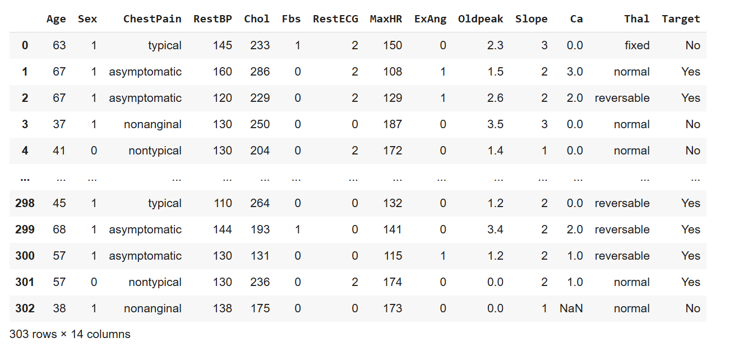
Dataset

Slide 4
Dataset Description
We're using the Heart.csv dataset, which contains various medical and demographic attributes related to heart disease:
Age: Age in years
Sex: Gender (Male/Female)
ChestPain: Type of chest pain experienced (categorical)
RestBP: Resting blood pressure (mm Hg)
Chol: Serum cholesterol (mg/dl)
Fbs: Fasting blood sugar > 120 mg/dl
RestECG: Resting electrocardiographic results
MaxHR: Maximum heart rate achieved
ExAng: Exercise induced angina
Oldpeak: ST depression induced by exercise relative to rest
Slope: Slope of the peak exercise ST segment
Ca: Number of major vessels colored by fluoroscopy
Thal: Thalassemia (a blood disorder) (categorical)
Target: Presence of heart disease (Yes/No) (categorical)

Slide 5

Question: What features of the dataset are best for determining the presence of heart disease?
Notes:
Expected Results
We anticipate that clinical measurements like maximum heart rate, ST depression (Oldpeak), number of major vessels (Ca), and cholesterol will be strong predictors of heart disease. We expect demographic factors like sex might be less predictive, though this remains to be tested through our analysis.

Slide 6

Filter Methods
Filter Methods utilize statistical tests like ANOVA and Chi-square to see which features have the most impact on our target.
Works by computing a statistical score between each feature and the target variable
Pros: fast and scalable, not tied to any model
Cons: ignores interactions between features, doesn’t consider how the model will use the features
Use Case: Great for preprocessing before more advanced methods

Slide 7
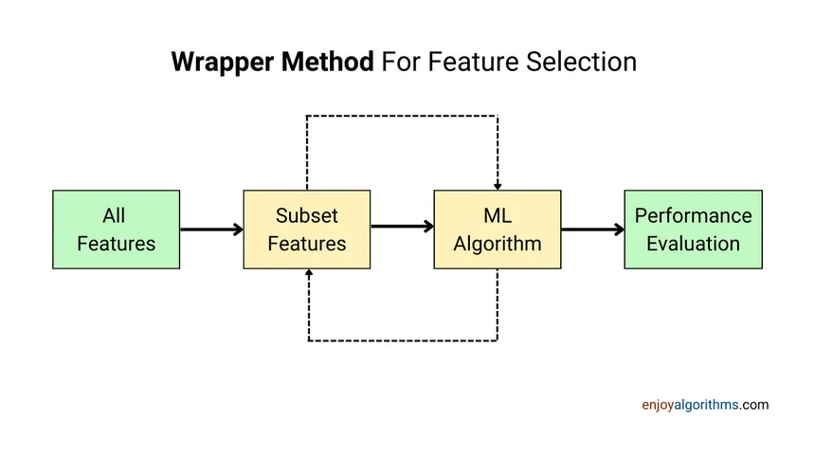
Wrapper Method
This method treats feature selection as a search problem and tries different combinations of features and evaluate the performance of each subset
Pros: takes into account interactions between features, often gives better results than filter methods
Cons: computationally expensive, can overfit if your not careful
Use Case: Use when model performance is a top priority and can take the computational cost
Notes:
Works by selecting a subset of features, training a model on that subset, and using the model’s performance to guide the search

Slide 8
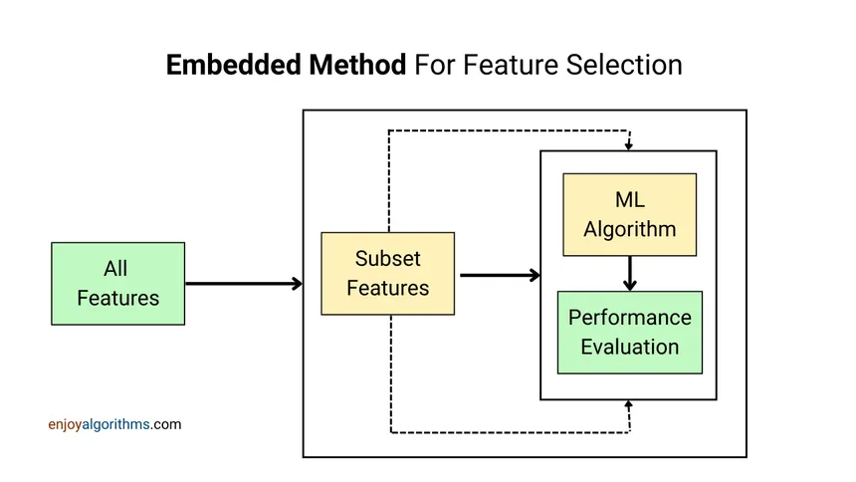
Embedded Methods
Embedded methods treat feature selection as part of the model training process
Pros: Balances accuracy and efficiency, usually more robust and faster than wrappers
Cons: specific algorithms must be used, you may need to retrain if switching models
Use case: Best when you want a balance of performance and efficiency with built-in selection.
Notes:
Works by having algorithms select features during training by penalizing complex models

